Slide 1
Measurement
What Is It and Why Do It?

Slide 2
Contents
Beneficiary of Measurement
Scope of Software Metrics

Slide 3
Quantification
two kinds of quantification:
measurement and
calculation.
Measurement is a direct quantification, as in measuring the height of a tree or the weight of a shipment of bricks.
Calculation is indirect, where we take measurements and combine them into a quantified item that reﬂects some attribute whose value we are trying to understand.
For example, when the city inspectors assign a valuation to a house. they calculate it by using a formula that combines a variety of factors, including the number of rooms, the type of heating and cooling, the overall ﬂoor space, and the sale prices of similar houses in comparable locations.
Direct vs Derived measurement

Slide 4
Example of Abstract attributes: Quality
There are no universally recognized measures to identify the best individual soccer players (although number of goals scored is a fairly accurate measure of quality of a striker). Although many fans and players have argued that player quality is an unmeasurable attribute, there are organizations (such as optasports.com) that provide player ratings based on a wide range of measurable attributes such as tackles, saves, or interceptions made; frequency and distance of passes (of various types), dribbles, and headers. Soccer clubs, agents, betting, and media companies pay large sums to acquire these ratings. Often clubs and players’ agents use the ratings as the basis for determining player value (both from a salary and transfer price perspective).
Notes:
In European soccer leagues, a points system is used to select the best all-around team over the course of a season. Until the early 1980s, two points were awarded for each win and one point was awarded for each draw. Thereafter, the points system was changed; a win yielded three points instead of two, while a draw still yielded one point. This change was made to reﬂect the consensus view that the qualitative difference between a win and a draw was greater than that between a draw and a defeat

Slide 5
Who Benefits From Measurement?
Managers:
What does each process cost?
For example, we can identify the cost to elicit requirements, the cost to specify the system, the cost to design the system, and the cost to code and test the system.
How productive is the staff?
We can measure the time it takes for staﬀ to specify the system, design it, code it, and test it.
To estimate the cost and duration of the change.
How good is the code being developed?
By carefully recording faults, failures, and changes as they occur, we can measure software quality
Will the user be satisfied with the product?
we can measure usability, reliability, response time, and other characteristics to suggest whether our customers will be happy with both functionality and performance
How can we improve?
We can measure the time it takes to perform each major development activity, and calculate its eﬀect on quality and productivity.
for example, we can compare two methods to see which one yields the higher-quality code.

Slide 6
Who Benefits From Measurement?
Engineers:
Are the requirements testable?
For example, suppose a requirement states that a web-based system must be “fast”.
the mean response time to a set of specific of inputs must be less than 2s for specified browsers and number of concurrent users.
Have we found all the failures?
faults in the specification, design, code, and test plans and trace them back to their root causes.
Have we met our product or process goals?
measure characteristics of the products and processes
For example: we can mandate that unit testing must achieve 90% statement coverage.
What can we predict about our software product in the future?
For example, measures of size of specifications can be used to predict the size of the target system

Slide 7
Scope of Software Metrics
Cost and effort estimation
Productivity measures and models
Data collection
Quality models and measures
Reliability models
Security metrics
Performance evaluation and models
Structural and complexity metrics
Capability maturity assessment
Management by metrics
Evaluation of methods and tools

Slide 8
Cost and effort estimation
Software cost estimation is the process of predicting the amount of effort required to build a software system.
Estimates for project cost and time requirements are derived during the planning stage of a project.
Managers provided the original motivation for deriving and using software measures.
Models used to estimate cost can be COCOMO (e.g., Constructive Cost Model) or Function Point Model
Eﬀort is expressed as a (predefined) function of one or more variables (such as size of the product, capability of the developers, and level of reuse)
Experience is often the only guide used to derive these estimates, but it may be insufficient if the project breaks new ground. Many models are available as automated tools.
Notes:
Cocomo (Constructive Cost Model) is a regression model based on LOC, i.e number of Lines of Code. It is a procedural cost estimate model for software projects and often used as a process of reliably predicting the various parameters associated with making a project such as size, effort, cost, time and quality.
It was proposed by Barry Boehm in 1970 and is based on the study of 63 projects
https://pm.stackexchange.com/questions/14882/what-does-person-month-mean-in-development-time
https://www.geeksforgeeks.org/software-engineering-cocomo-model/
It's mean amount of work performed by the average worker in one month.
Function point metrics provide a standardized method for measuring the various functions of a software application. It measures the functionality from the user’s point of view, that is, on the basis of what the user requests and receives in return. Function point analysis is a standard method for measuring software development from the user's point of view.

Slide 9
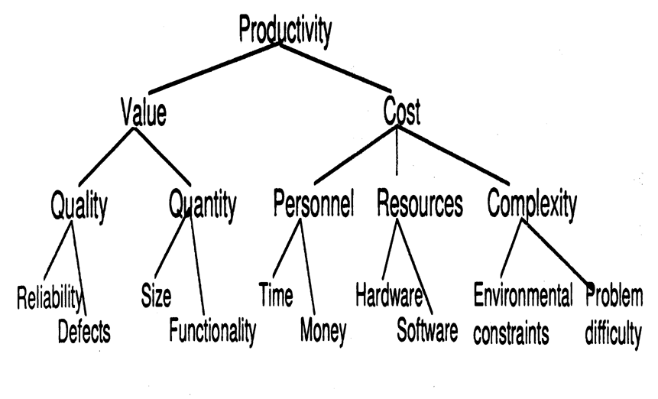

Productivity models and measures
Definition: The rate of output per unit of input.
Productivity = size / effort
= LOC / person-month
Productivity model based on decomposition to measurable attributes:
measurable

Slide 10
Data collection
Very critical and very hard step.
What data should be collected?
How it should be collected?
Is collected data reproducible?
Example: software failure data collection
Time of failure
Time interval between failures
Cumulative failure up to a given time
Failures experienced in a time interval

Slide 11
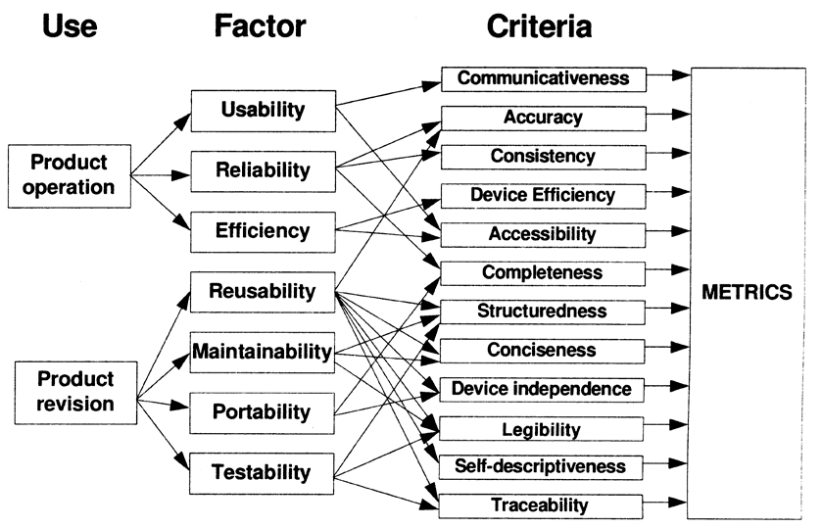
Quality models and measures
software quality involves many diverse factors, software engineers have developed models of the interaction between multiple quality factors.

Slide 12
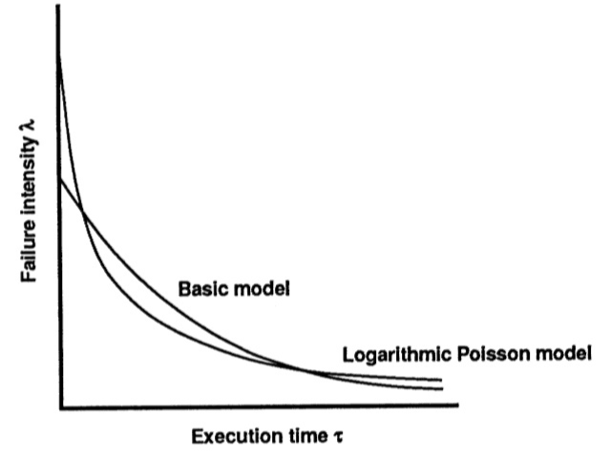
Reliability models
Plot the change of failure intensity (λ) against time.
Many models are proposed. The most famous ones are basic exponential model and logarithmic Poisson model.
Automated tools such as CASRE are available.
R(t) = e - (𝛌/t)
Notes:
-λ₀: stands for the initial failure intensity at the start of the execution.
-v₀: stands for the total number of failures occurring over an infinite time period; it corresponds to the expected number of failures to be observed eventually.
Theta: failure intensity decay parameter.
http://www.cse.cuhk.edu.hk/~lyu/book/reliability/casre.html

Slide 13
Security metrics
the security concern of software systems have grown rapidly.
We worry that attackers will steal or corrupt data files, passwords, and our accounts.
some standard ways to assess security risks in terms of impact, likelihood, threats, and vulnerabilities.

Slide 14
Performance evaluation and models
Using externally observable performance characteristics such as response time and completion rate
We can calculate Efficiency of algorithms

Slide 15


Structural and complexity metrics
Control-flow structure
Data-flow structure
Data structure Information
Complexity metrics
Cyclomatic complexity (McCabe 1989) defining number of independent paths in execution of a program
V(F) = 5

Slide 16
Management by metrics
Metrics for project control (1980~)
Metrics related to specification quality
Metrics for the design model
Metrics for documentation
Checking and testing metrics
Resource metrics
Change metrics

Slide 17
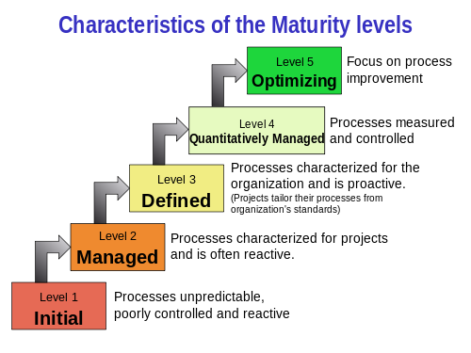
Capability maturity assessment
US Software Engineering Institute (SEI) model (1989): CMM grading using five-level scale.
ISO 9000-3: Guidelines for application of ISO 9001 to the development, supply and maintenance of software (1991)

Slide 18
Evaluation of methods and tools
Efficiency of methods (1991~)
Efficiency and reliability of tools
Certification test of acquired tools and components
Benchmarking
Notes:
But it is difficult to separate the claims from the reality. Many organizations perform experiments, run case studies, or administer surveys to help them decide whether a method or tool is likely to make a positive diﬀerence in their particular situations.

Slide 19
Exercise
Suppose that you are asked to study various software development tools and recommend the best three to your company. The following table shows a list of available development tools.

Slide 20
Exercise
Tool Name/Vendor | Languages Supported | Platforms | Features
Bean Machine IBM | Java | Windows, OS2, Unix | Best: Visual applet and JavaBean generation
CodeWarrior Pro Metrowerks | Java, C, C++, Pascal | Unix, Windows, Mac | Best: if you need to support Unix, Windows, and Mac platforms
Java Workshop Sun Microsystems | Java | Solaris, Windows | Better: Written 100% in Java; tools based on a web browser metaphor
JBuilder Imprise | Java | Windows, AS400 | Better: database support
Visual Cafe for Java Symantec | Java | Windows | Good: multithreaded debugger
VisualAge IBM | Java | Unix, Windows | Good: includes incremental compiler and automatic version control
Visual J++ Microsoft | Java | Windows | Fair: All the bells and whistles for Windows

Slide 21
Exercise
What are the entities, attributes and their values in your model?
Entity | Attribute | Value
Development Tool | Language supported | Java, C, C++, Pascal
 | Platform | Win, Unix, Mac, OS2, AS400
 | Feature | Fair, Good, Better, Best

Slide 22
How to Implement?
The eight steps required to implement a software measurement program are:
Document the software development process
State the goals
Define metrics required to reach goals
Identify data to collect
Define data collection procedures
Assemble a metrics toolset
Create a metrics database
Define the feedback mechanism

Slide 23
Conclusion
Without measurements there is no way to determine if the process/product are improving.
Metrics allow the establishment of meaningful goals for improvement. A baseline from which improvements can be measured can be established.
Metrics allow us to identify the causes of defects which have major effect on software development.
When metrics are applied to a product they help identify:
which user requirements are likely to change
which modules are most error prone
how much testing should be planned for each module

